Slide 1
14TH Annual SAA 2020 Research Forum
#SAA20RF @SAAResearch
August 5, 2020
On Zoom

Slide 2
#SAA20RF @SAAResearch
Welcome!
We’d like to begin by acknowledging that Chicago—which is our virtual host for this conference and is home to the SAA office—is located on the ancestral lands of several Indigenous tribes, including the Kickapoo, Peoria, Potawatomi, and Illinois Nations. I encourage you to acknowledge the ancestral lands on which you find yourself today, and to do so with intention. Thank you.
Note: drafted in consultation with the Native American Archives Section co-chairs
Native Governance Center has a guide to Indigenous land acknowledgement for you to use in understanding what a land acknowledgement is and guidance for creating one. https://nativegov.org/a-guide-to-indigenous-land-acknowledgment/

Slide 3
#SAA20RF @SAAResearch
Thank you!
Research Forum Organizing Team
Carolyn Hank (U Tennessee Knoxville) – Program Committee
Ardys Kozbial (Harvard) – Program Committee
Nance McGovern (MIT) – Forum Co-chair/Co-founder, Program Committee Co-chair
Gabriela Redwine (Yale) – Program Committee
Kate Neptune (Harvard) – Forum Coordinator, Overall and Platforms
Kari Smith (MIT) – Program Committee and Forum Lead Organizer
Heather Soyka (Kent State) – Forum Co-chair, Program Committee Co-chair
Rebecca C. Thayer (College of Charleston) – Forum Coordinator, Posters and Technical
Helen Tibbo (UNC Chapel Hill) – Forum Co-founder, Program Committee
SAA Staff: Nancy, Felicia, Matt, Carlos, and Akila (who will be with is today)
All of our Research Forum Presenters
All of our attendees and viewers

Slide 4
#SAA20RF @SAAResearch
Agenda for Today
Full agenda at:
https://www2.archivists.org/am2020/research-forum-2020/agenda
Abstracts and bios are available (as usual) via links on the agenda -
And slides, poster images, and eventually research reports and papers will also be available on the 2020 Research Forum website
All of the sessions, including the Poster session, will be recorded.
Recordings will be available with other Annual Meeting content – for the first time!

Slide 5
#SAA20RF @SAAResearch
Focus sessions this year:
Professional Identity (Session 2 – 11:30 – 12:30 CDT)
Builds on last year’s Radical Collaboration session
Research and SAA (Session 5 – 4:20-4:50 CDT)

Slide 6
#SAA20RF @SAAResearch
American Archivist Editor
An invitation from Cal Lee, AA Editor, to 2020 Research Forum Presenters …

Slide 7
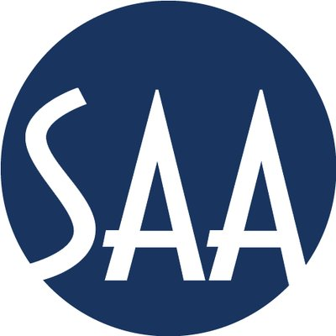
American Archivist as a Venue for your Research
Christopher (Cal) Lee
School of Information and Library Science
University of North Carolina at Chapel Hill
Editor, American Archivist
Society of American Archivists Research Forum August 5, 2020

Slide 8
In addition to publishing in the Research Forum proceedings, there’s a strong tradition of publishing Research Forum contributions through American Archivist.

Slide 9
Research Forum Contribution [Research Forum Year] | Associated American Archivist Article
Understanding On-line Use through Web Analytics - Christopher J. Prom [2007] | Prom, Christopher. “Using Web Analytics to Improve Online Access to Archival Resources.” American Archivist 74, no. 1 (2011): 158-184. https://doi.org/10.17723/aarc.74.1.h56018515230417v
Beyond Image Retrieval: Bridging Digitization Processes and End-User Judgments in a Large-Scale Image Digital Library - Paul Conway [2007] | Conway, Paul. “Modes of Seeing: Digitized Photographic Archives and the Experienced User.” American Archivist 73, no. 2 (2010): 425-462. https://doi.org/10.17723/aarc.73.2.mp275470663n5907
Digitizing Photographs: Exploring the Relationship Between Building and Using Image Digital Archives - Paul Conway [2008]
How Do Expert Users Judge Archival Qualities in Digitized Photographs? – Paul Conway [2009]
Preserving Electronic Mailing Lists as Scholarly Resources: The H-Net Archives – Lisa M. Schmidt [2008] | Schmidt, Lisa. “Preserving the H-Net Email Lists: A Case Study in Trusted Digital Repository Assessment.” American Archivist 74, no. 1 (2011): 257-296. https://doi.org/10.17723/aarc.74.1.u2jw67r7257wqw66
Business process management and archival content management systems – Gordon Daines and Cory Nimer [2009] | Daines, J. Gordon, III. “Re-engineering Archives: Business Process Management (BPM) and the Quest for Archival Efficiency.” American Archivist 74, no. 1 (2011): 123-157. https://doi.org/10.17723/aarc.74.1.h8159344u8331165
Re-Engineering Archives: Business Process Management (BPM) and the Archival Quest for Efficiency - Gordon Daines [2010]
Copyright Practices of Archival Repositories and Their Impact on Users - Jean Dryden [2010] | Dryden Jean. “Copyfraud or Legitimate Concerns? Controlling Further Uses of Online Archival Holdings.” American Archivist 74, no. 2 (2011): 522-543. https://doi.org/10.17723/aarc.74.2.d5g2700q5612l4w7
How Archivists View Copyright - Jean Dryden [2011] | Dryden, Jean. “The Role of Copyright in Selection for Digitization.” American Archivist 77, no. 1 (2014): 64-95. https://doi.org/10.17723/aarc.77.1.3161547p1678423w
Are Archivists Control Freaks?: Controlling Further Uses of Online Content - Jean Dryden [2012

Slide 10
Research Forum Contribution [Research Forum Year] | Associated American Archivist Article
Virtual Reunification: Bits and Pieces Put Together to Form a Semblance of a Whole - Ricky Punzalan [2012] | Punzalan, Ricardo. “Archival Diasporas: A Framework for Understanding the Complexities and Challenges of Dispersed Photographic Collections.” American Archivist 77, no. 2 (2014): 326-349. https://doi.org/10.17723/aarc.77.2.729766v886w16007
Archival Dispersion and Virtual Reunification: Toward a Framework for Representing the Complexities and Dimensions of Dispersion - Ricardo L. Punzalan [2013]
Who’s Ready to Surf The Next Wave? A Study of Perceived Challenges to Implementing New and Revised Standards for Archival Description - Frank Lambert and Karen F. Gracy [2013] | Gracy, Karen and Frank Lambert. “Who's Ready to Surf the Next Wave? A Study of Perceived Challenges to Implementing New and Revised Standards for Archival Description.” American Archivist 77, no. 1 (2014): 96-132. https://doi.org/10.17723/aarc.77.1.b241071w5r252612
How Historians Search for, Access, and Use Primary Source Materials - Alexandra Chassanoff [2013] | Chassanoff, Alexandra. “Historians and the Use of Primary Source Materials in the Digital Age.” American Archivist 76, no. 2 (2013): 458-480. https://doi.org/10.17723/aarc.76.2.lh76217m2m376n28
Scientific Data Curation in Government Agencies: Teaching Agency Data Creators How to Develop an OAIS-Compliant Digital Curation System - Lorraine L. Richards and William C. Regli [2014] | Richards, Lorraine L. “Teaching Data Creators How to Develop an OAIS-Compliant Digital Curation System: Colearning and Breakdowns in Support of Requirements Analysis.” American Archivist 79, no. 2, (2016): 371-391. https://doi.org/10.17723/0360-9081-79.2.371
How We Can Use What We Already Know to Learn More: An Ontology for Linking Curriculum to Cultural Heritage - Sonia Yaco, Arkalgud Ramaprasad, Saleha Rizvi [2016] | Yaco, Sonia, Caroline Brown, and Lee Konrad. “Linking Special Collections to Classrooms: A Curriculum-to-Collection Crosswalk.” American Archivist 79, no. 2 (2016): 417-437. https://doi.org/10.17723/0360-9081-79.2.417
Our Archives, but Not Ourselves: Filling the Gap of Research About Women Archivists - Alexandra A.A. Orchard, Kristen Chinery, Leslie Van Veen McRoberts, Alison Stankrauff [2016] | Orchard, Alexandra A. A. Kristen Chinery, Alison Stankrauff, and Leslie Van Veen McRoberts. “The Archival Mystique: Women Archivists Are Professional Archivists.” American Archivist 82, no. 1 (2019): 53-90. https://doi.org/10.17723/0360-9081-82.1.53

Slide 11
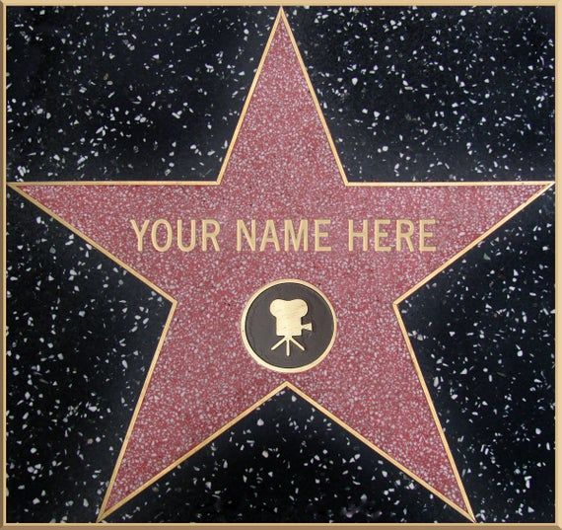
Research Forum Contribution [Research Forum Year] | Associated American Archivist Article
Evaluating How Archival Websites Allow Researchers to Prepare for an In-Person Visit - Scott Pitol [2017] | Pitol, Scott P. “Evaluating How Well an Archival Website Allows a Researcher to Prepare for an On-Site Visit.” American Archivist 82, no. 1 (2019): 137-154. https://doi.org/10.17723/0360-9081-82.1.137
The State of Reappraisal and Deaccessioning in Archives - Marcella (Wiget) Huggard, Laura Uglean Jackson [2017] | Huggard, Marcella and Laura Uglean Jackson “Practices in Progress: The State of Reappraisal and Deaccessioning in Archives.” American Archivist 82, no. 2 (2019): 508-547. https://doi.org/10.17723/aarc-82-02-04
Moving Image Social Tagging: Professional vs. Amateur Production Comparison - Edward Benoit [2017] | Benoit, Edward Benoit, III. “#MPLP Part 1: Comparing Domain Expert and Novice Social Tags in a Minimally Processed Digital Archives.” American Archivist 82, no. 2 (2017): 407-438. https://doi.org/10.17723/0360-9081-80.2.407
Student Employment Matters: Mapping Literacies and Learning Outcomes in Special and Digital Collections - Erin Passehl-Stoddart [2017] | Erin Passehl-Stoddart, Erin. “’Let Me Tell You What I Learned’: Primary Source Literacy and Student Employment in Archives and Special Collections.” American Archivist 81, no. 2 (2018): 438-459. https://doi.org/10.17723/0360-9081-81.2.438

Slide 12
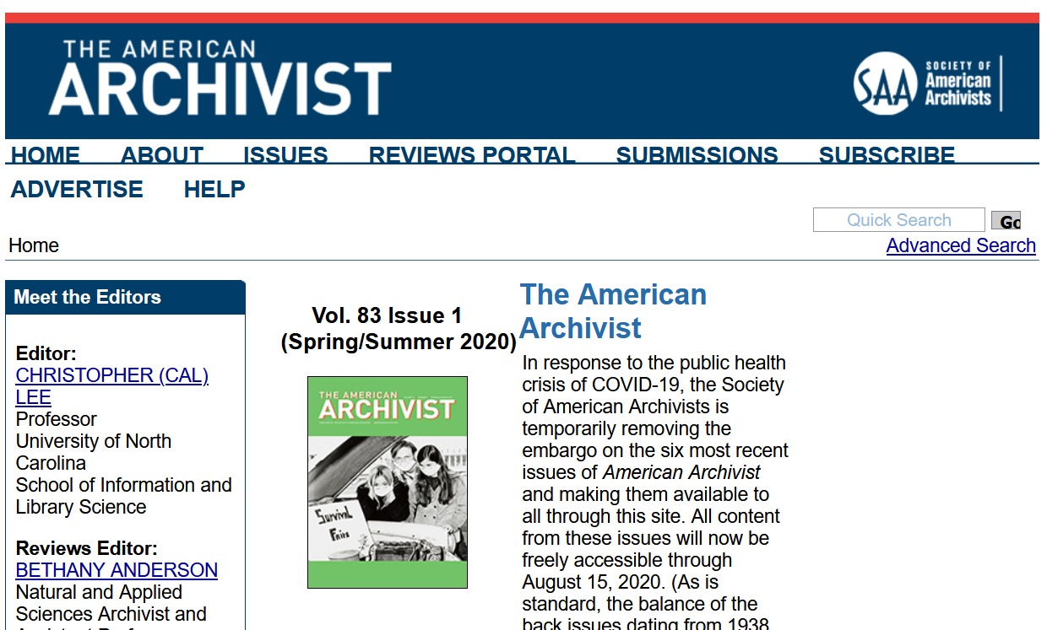
Register as a reviewer (through PeerTrack)
Contact Editor or other Editorial Board members with questions, comments or ideas for articles or book reviews
Read guidance for authors
Submit an article
https://americanarchivist.org/

Slide 13
#SAA20RF @SAAResearch
Virtual Research Forum Team
Nance McGovern – forum host, session facilitator, hopeful realist
Kari Smith – session facilitator and Zoom wrangler
Heather Soyka – social media, Q&A fiddling, dot connector
Kate Neptune – Q&A coordination, notes, timekeeping, miracles
Rebecca C. Thayer – Q&A coordination, notes, timekeeping, team spirit
Thank you!

Slide 14
#SAA20RF @SAAResearch
Logistics
Notes for presenters and attendees – Kari
Codes of Conduct
SAA Code of Conduct
We value and respect our diverse guests, volunteers, service providers, and staff members. We expect all of our attendees to do the same. Read the SAA Code of Conduct https://www2.archivists.org/statements/saa-code-of-conduct
CoSA members and others deserve an organizational environment where each individual is treated with dignity and respect. Read CoSA's Code of Conduct https://www.statearchivists.org/files/2715/2370/9801/CoSA_Code_of_Conduct_2018.pdf

Slide 15
Ready? Let’s go!
#SAA20RF @SAAResearch

